Slide 1

Introduction to Graph Neural Networks
Slides by Iulia Duta

Slide 2
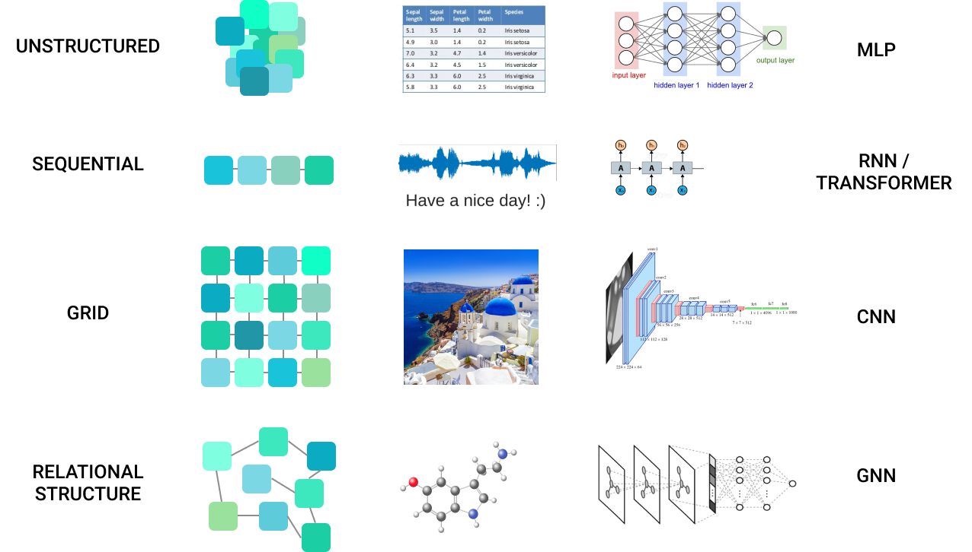

Slide 3
What we will cover?
1
How to represent a graph?
2
How to process a graph?
Message passing framework
GNN, GAT and others
3
Expressive power of graphs
Weisfeiler-Lehman test Counting substructures Techniques to improve the performance
4
Common issues in GNNs
over-smoothing
over-squashing
5
Hot topics and open problems

Slide 4
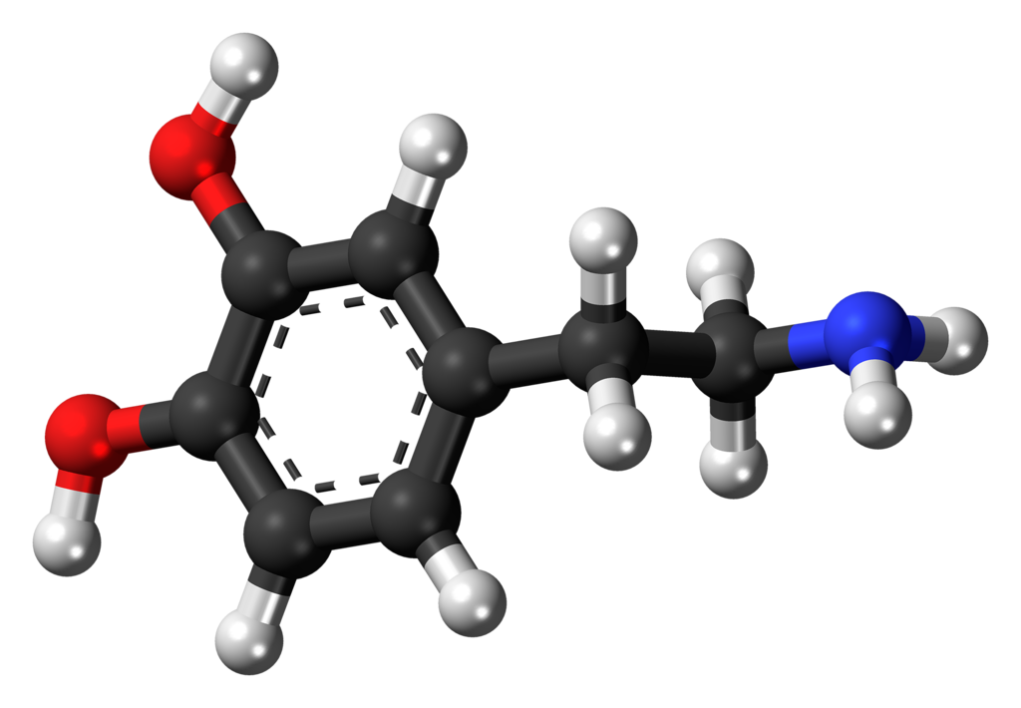

How to represent a graph?

Slide 5
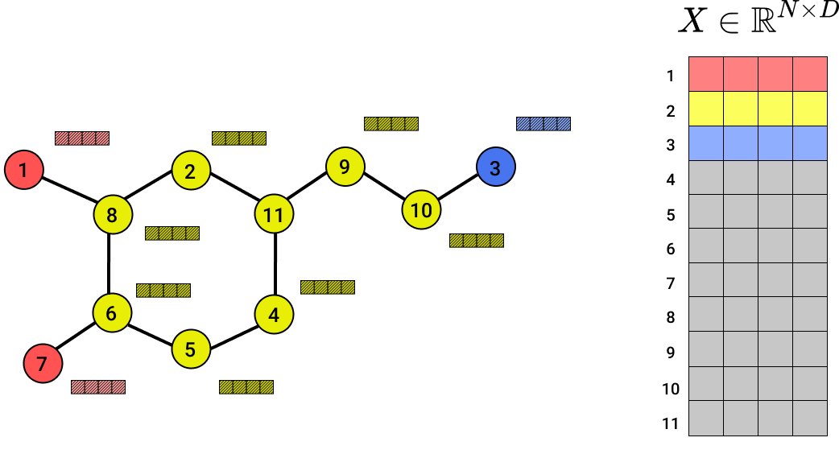
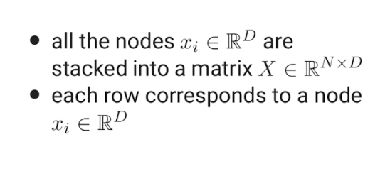
Feature matrix
Feature matrix

Slide 6
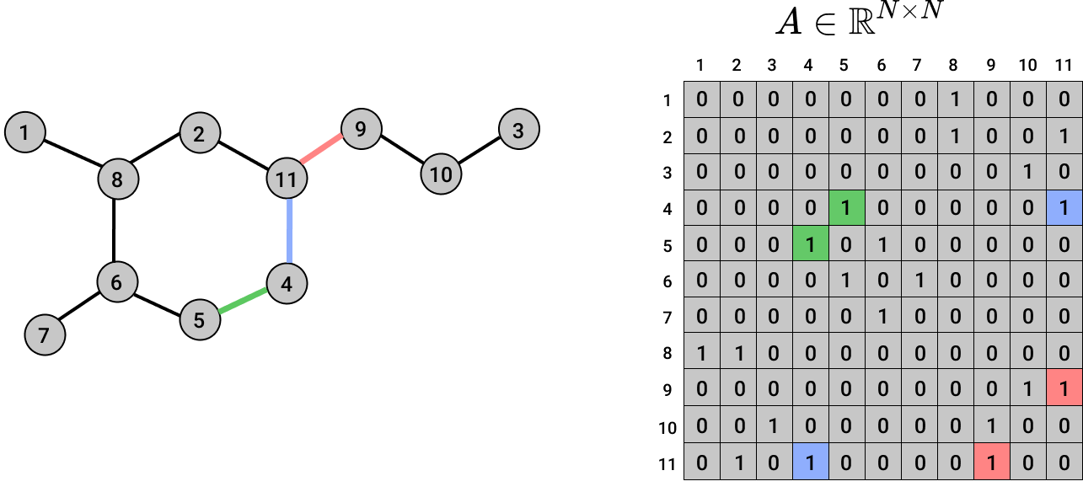
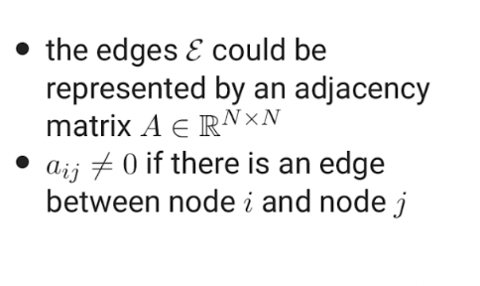
Graph structure: Nodes
Adjacency matrix

Slide 7

Graph structure: Edges
Adjacency matrix

Slide 8
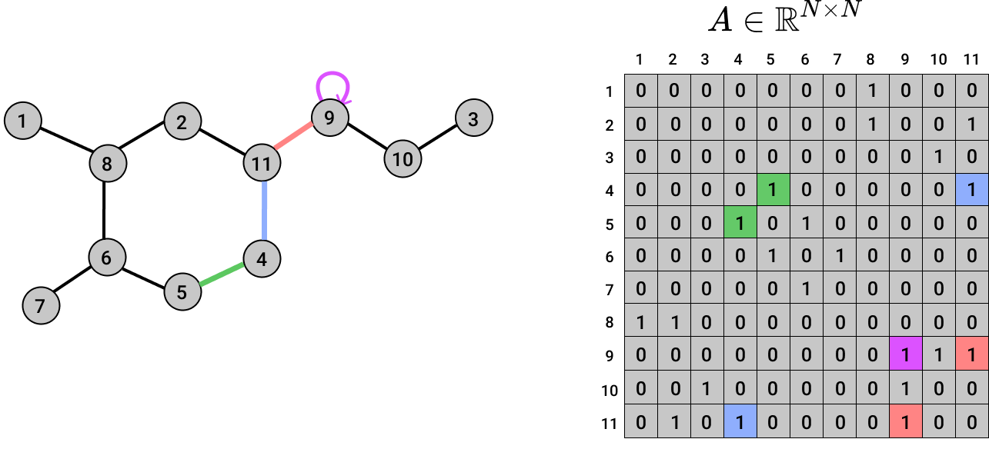
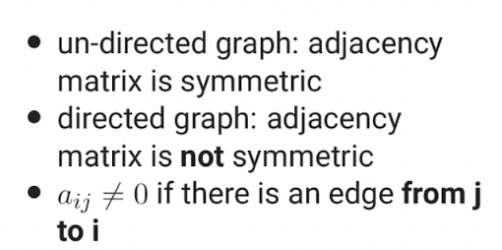
Graph structure: Edges
Adjacency matrix

Slide 9
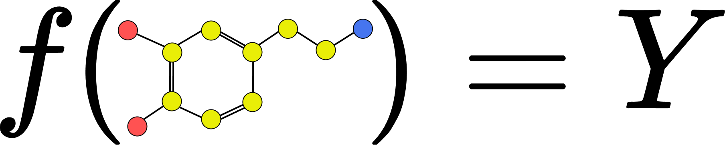
2. How to process a graph?

Slide 10
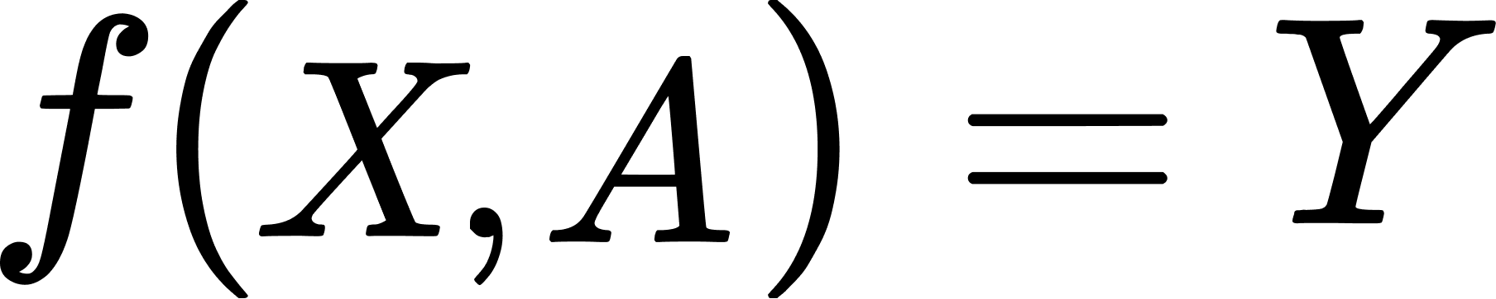
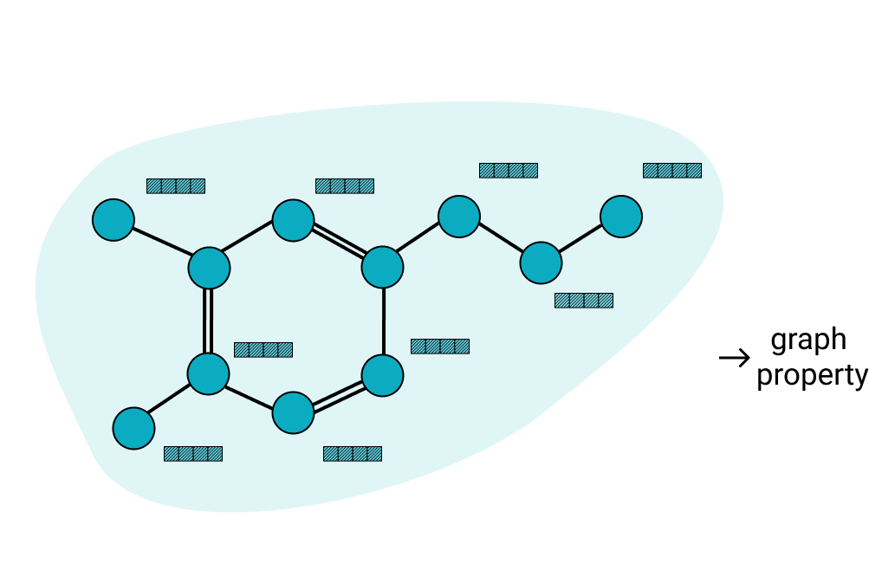
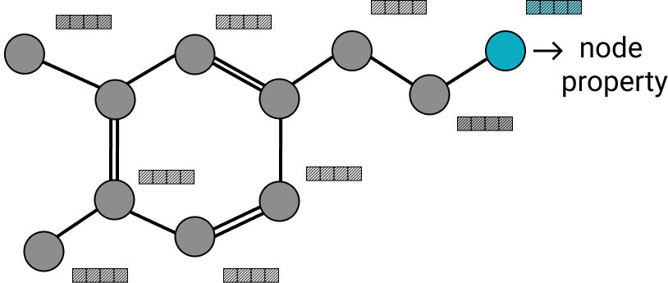
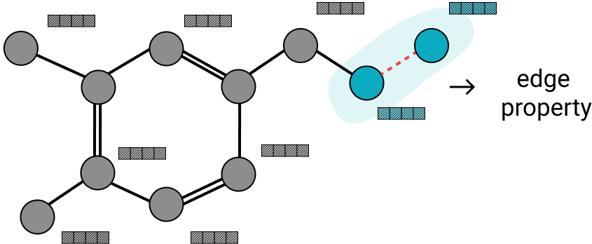
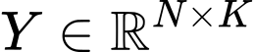
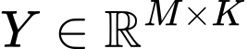
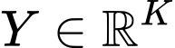
What tasks can we solve?
one prediction for each node
one prediction for each edge
single prediction for the entire graph

Slide 12
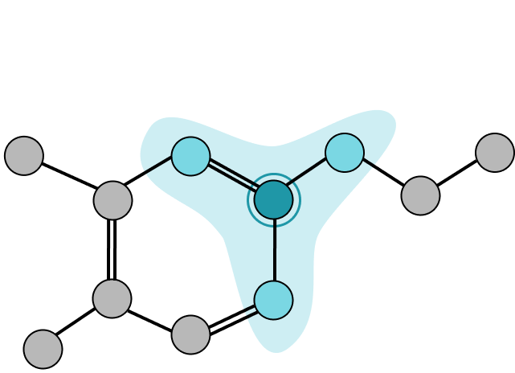
How do we process the graph?
Structure dependent: the processing should take into account the graph connectivity
the process should take into account how the nodes are connected
generally, a node should be influenced more by the nodes in its neighbourhood

Slide 13
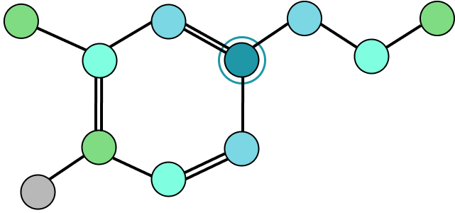
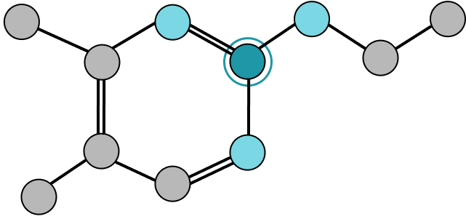
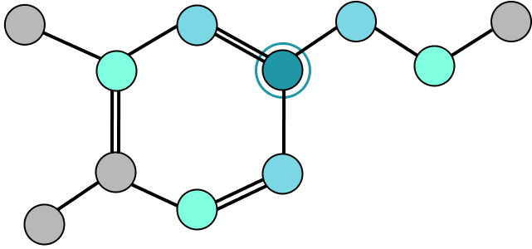
Neighbourhood
1-hop neighbourhood
2-hop neighbourhood
3-hop neighbourhood

Slide 14
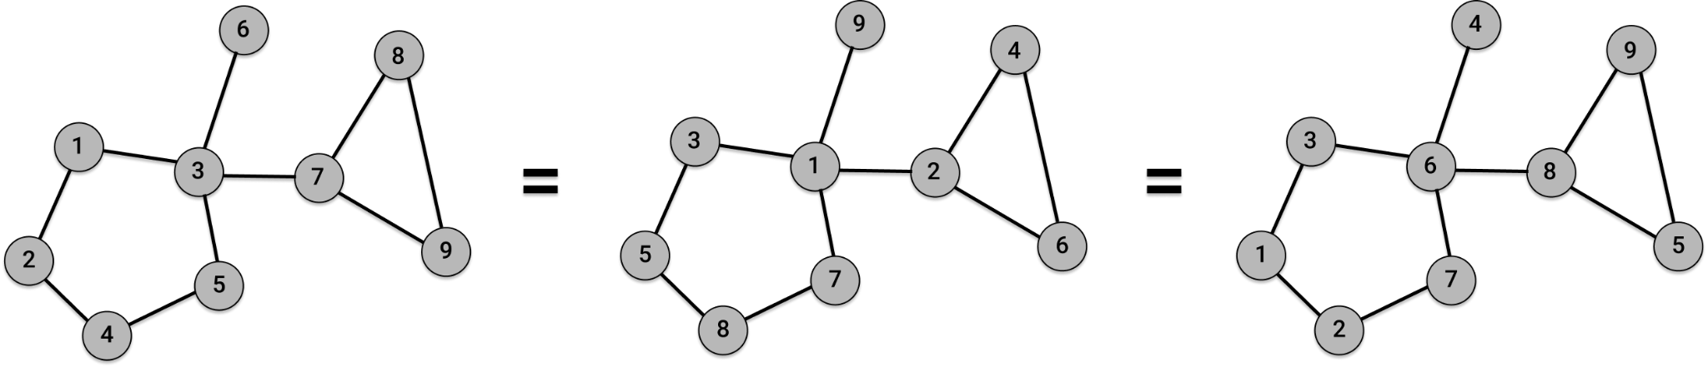
How do we process the graph?
There is no canonical order in a graph. The graph processing should not depend on our randomly picked order

Slide 15
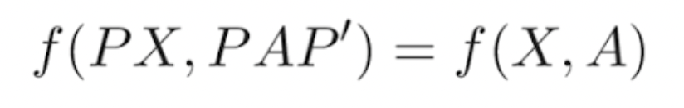
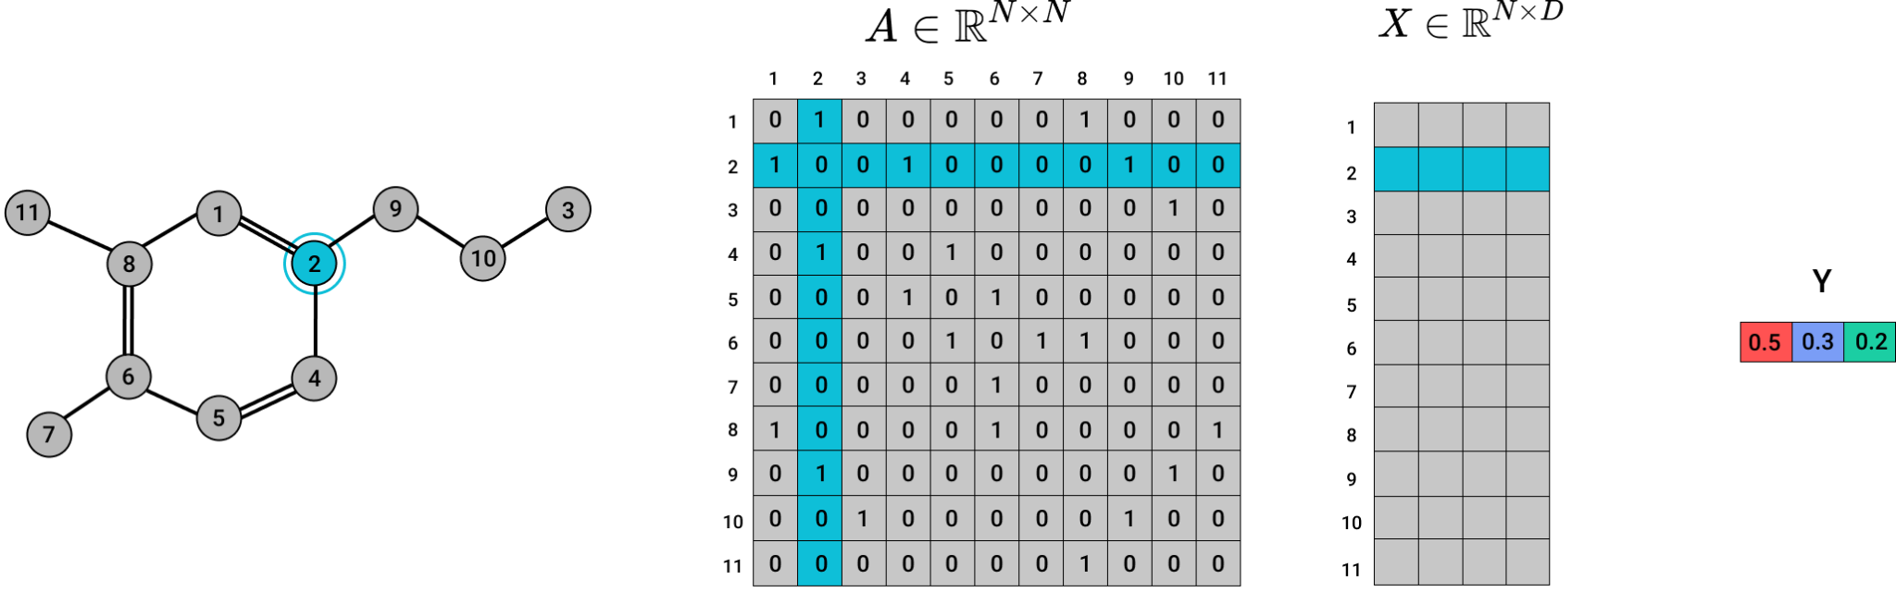
How do we process the graph?
Permutation invariant: the graph-level output should be invariant to the order of the nodes
There is no canonical order in a graph. The graph processing should not depend on our randomly picked order

Slide 16
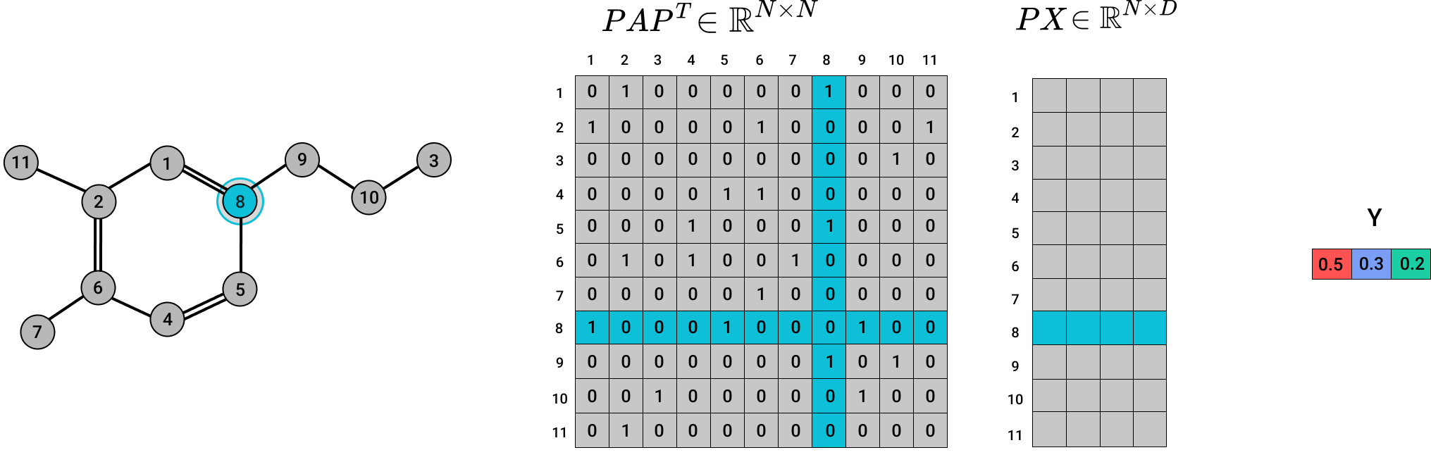
How do we process the graph?
Permutation invariant: the graph-level output should be invariant to the order of the nodes
There is no canonical order in a graph. The graph processing should not depend on our randomly picked order

Slide 17
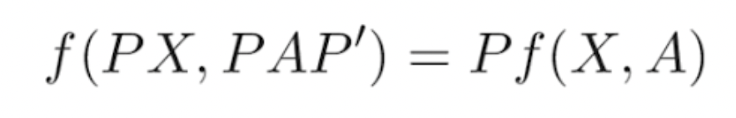
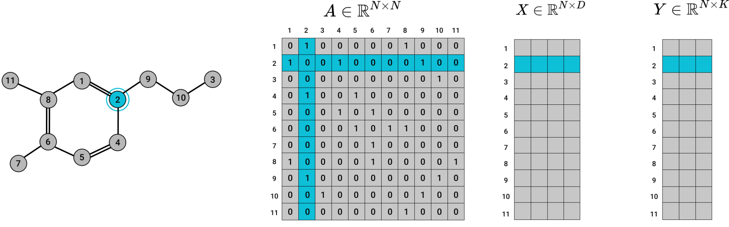
How do we process the graph?
Permutation equivariant: if we permute the order of the nodes, the nodes’ output should be permuted in the same way
There is no canonical order in a graph. The graph processing should not depend on our randomly picked order

Slide 18
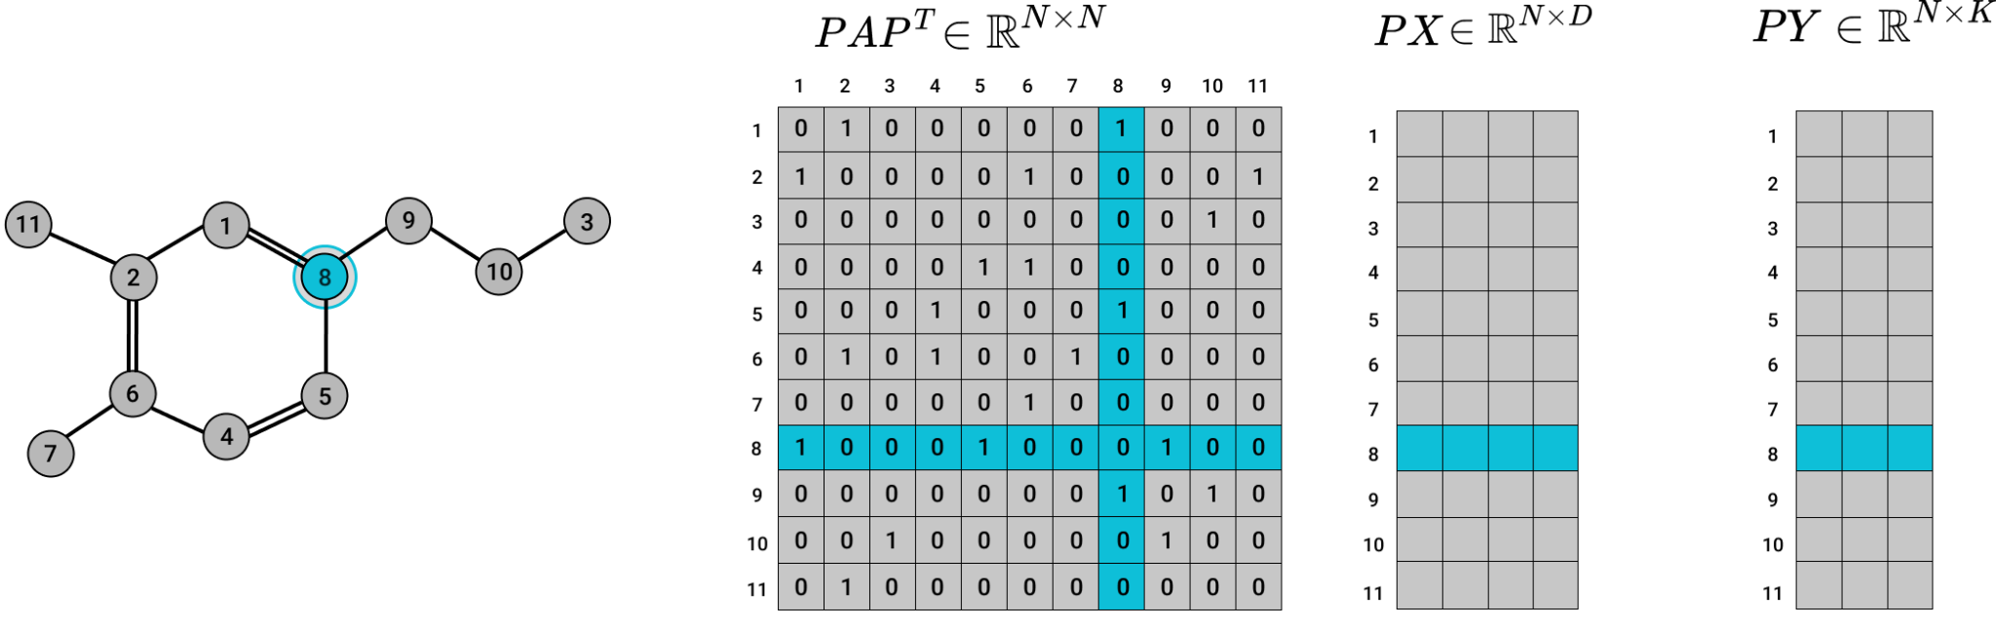
How do we process the graph?
Permutation equivariant: if we permute the order of the nodes, the nodes’ output should be permuted in the same way
There is no canonical order in a graph. The graph processing should not depend on our randomly picked order

Slide 19
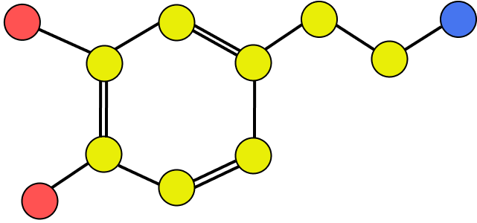
How do we process the graph?
Structure dependent: the processing should take into account the graph connectivity
Permutation invariant: the graph-level output should be invariant to the order of the nodes
Permutation equivariant: if we permute the order of the nodes, the nodes’ output should be permuted in the same way

Slide 20
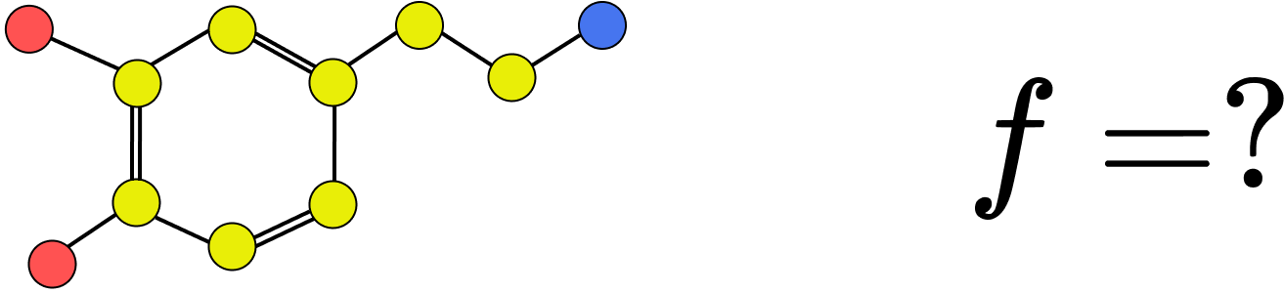
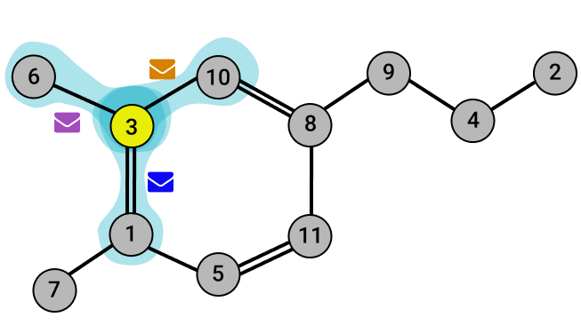
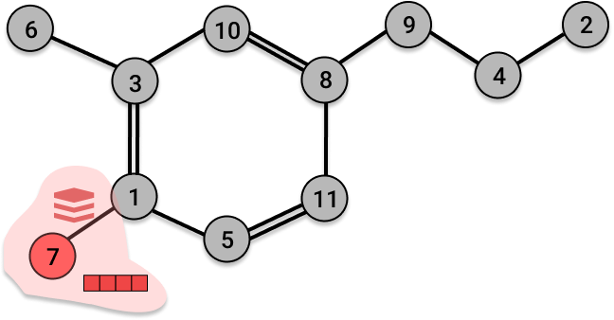
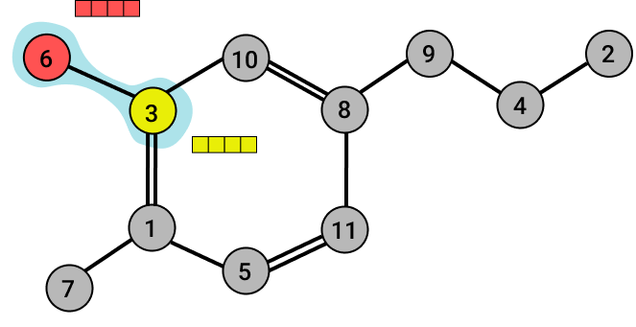
Message Passing Framework
1
Send
2
Aggregate
3
Update

Slide 21
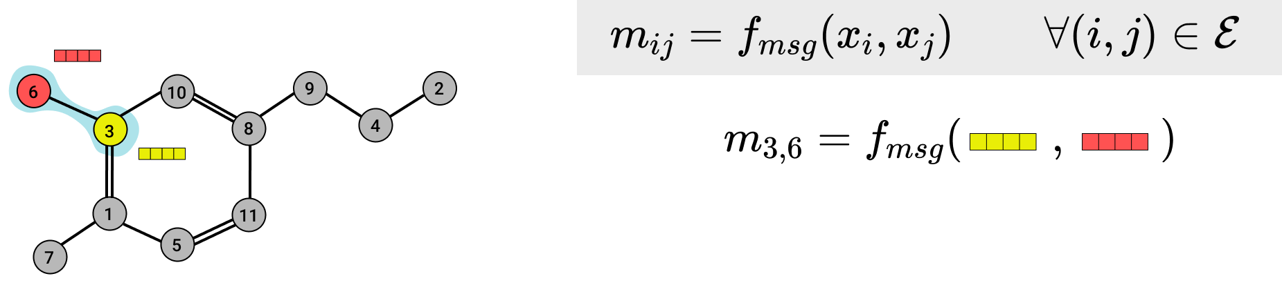
Message Passing Framework - Send
Send function: create a message from each pair of 2 nodes that are connected

Slide 22
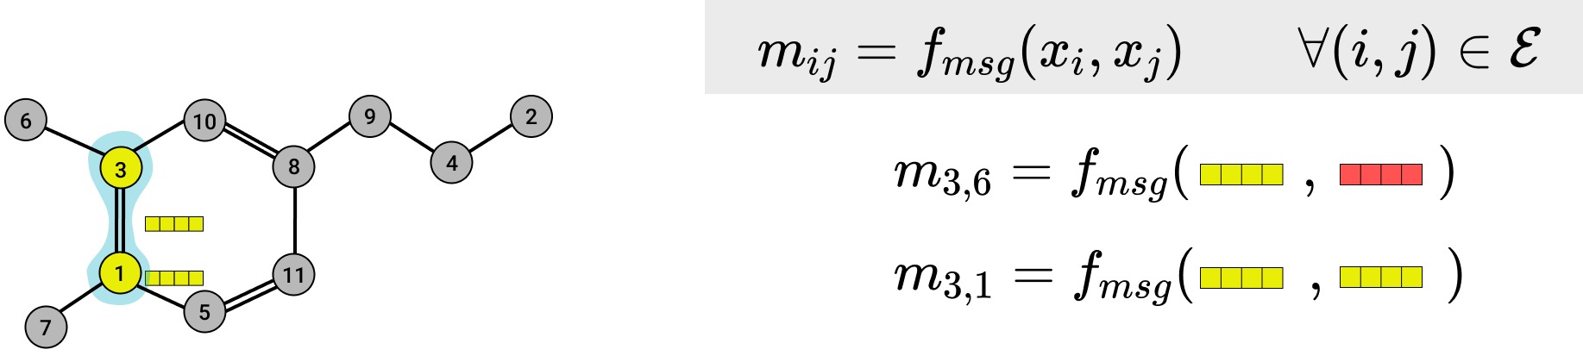
Message Passing Framework - Send
Send function: create a message from each pair of 2 nodes that are connected

Slide 23
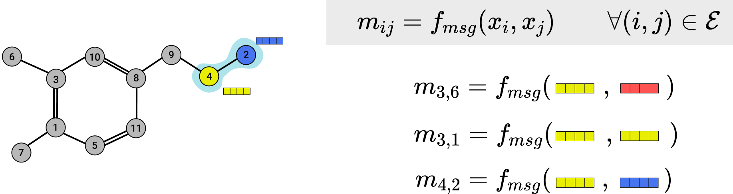
Message Passing Framework - Send
Send function: create a message from each pair of 2 nodes that are connected

Slide 24
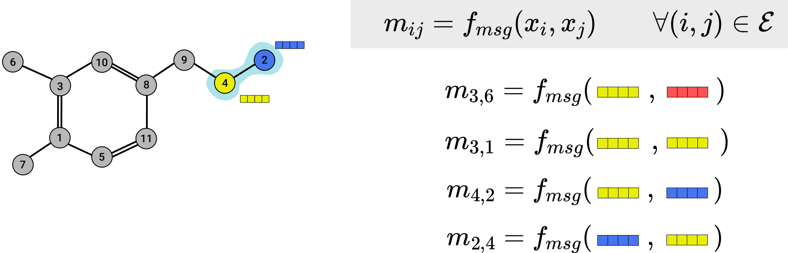
Message Passing Framework - Send
Send function: create a message from each pair of 2 nodes that are connected

Slide 25
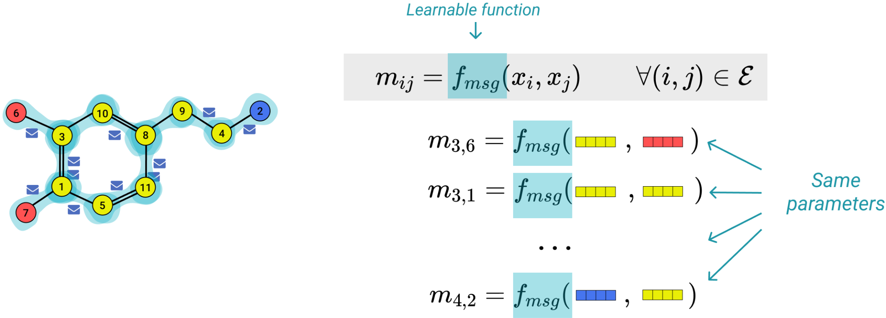
Message Passing Framework - Send
Send function: create a message from each pair of 2 nodes that are connected

Slide 26
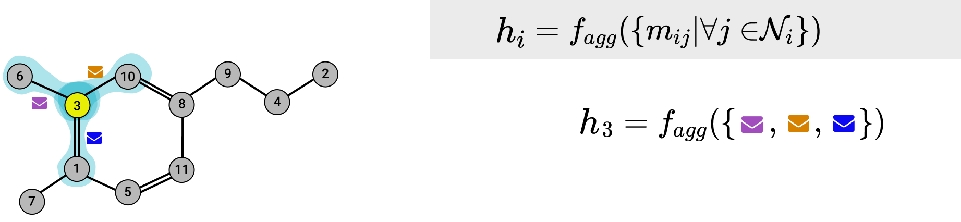
Message Passing Framework - Aggregate
Aggregate function: for each node, aggregate the messages from all its neighbours

Slide 27
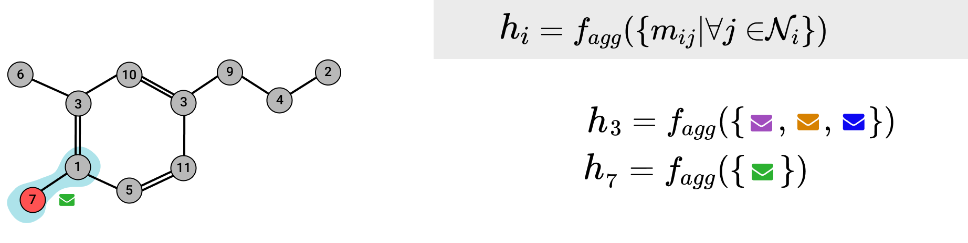
Message Passing Framework - Aggregate
Aggregate function: for each node, aggregate the messages from all its neighbours

Slide 28
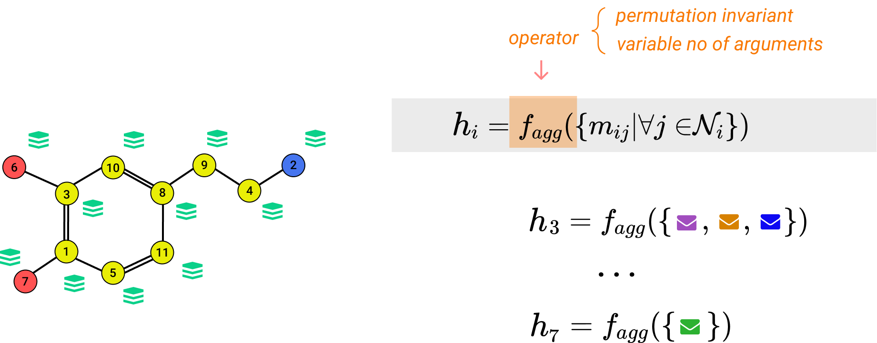
Message Passing Framework - Aggregate
Aggregate function: for each node, aggregate the messages from all its neighbours

Slide 29
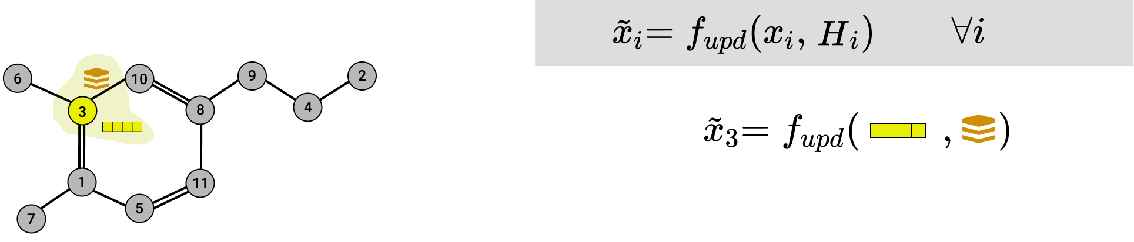
Message Passing Framework - Update
Update function: for each node, update its representation using the aggregated messages

Slide 30
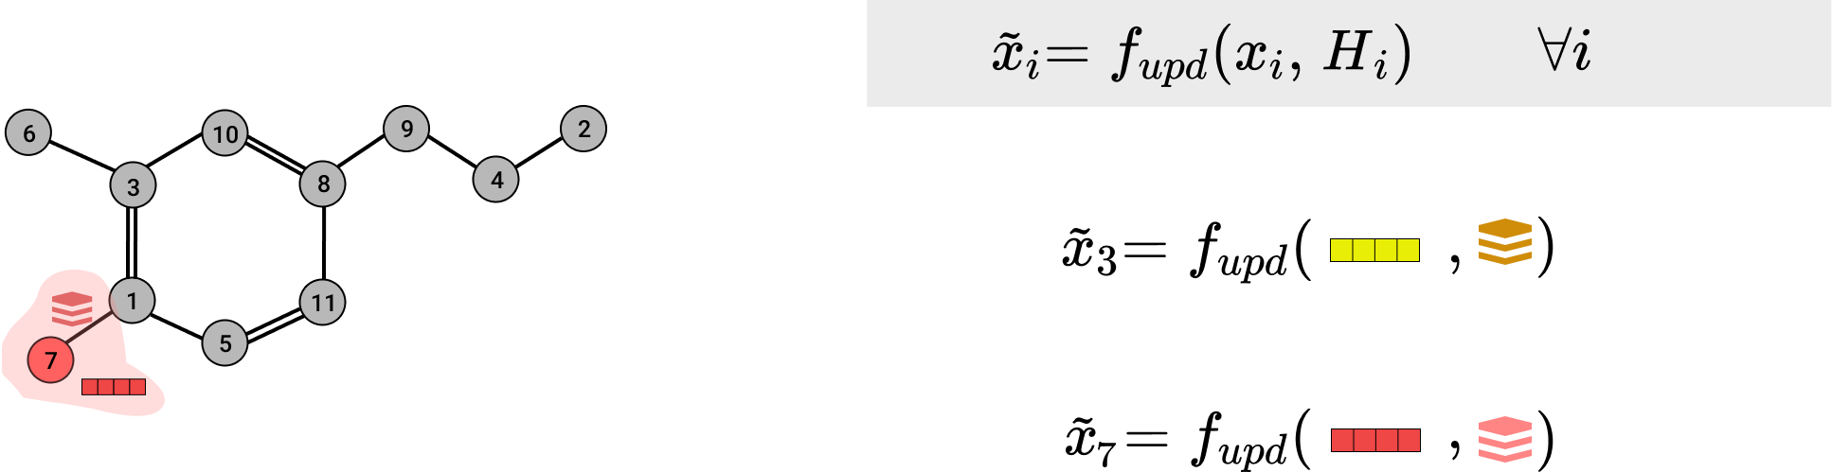
Message Passing Framework - Update
Update function: for each node, update its representation using the aggregated messages

Slide 31
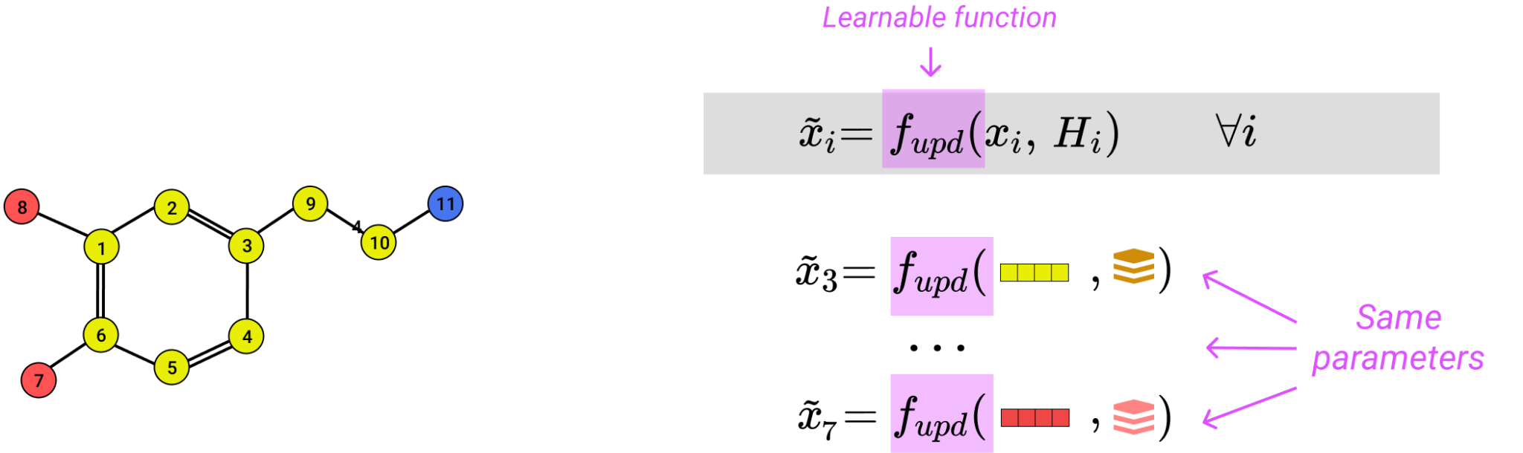
Message Passing Framework - Update
Update function: for each node, update its representation using the aggregated messages

Slide 32
Message Passing Framework - Overview
1
Send
2
Aggregate
3
Update

Slide 33
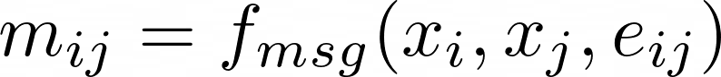
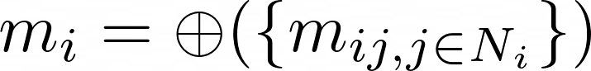
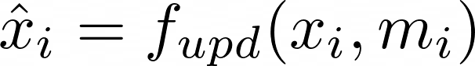
Message Passing Framework - Overview
1
Send
2
Aggregate
3
Update

Slide 34
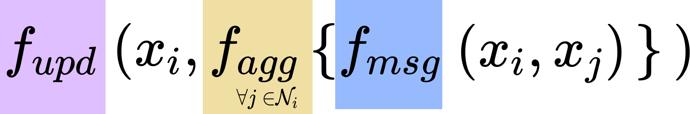
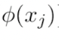
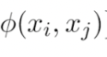
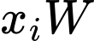
GNN flavours
Convolutional GNN
Attentional GNN
Message Passing
Send
Agg mean/sum attention mean/sum
+Agg
+Agg
Upd MLP

Slide 35



Convolutional GNN
📚
Kipf et al, Semi-Supervised Classification with Graph Convolutional Networks
Send
messages depend only on the source node
aggregation function is a simple mean/sum
it could be normalised according to the nodes degree
Agg mean/sum
Upd +Agg

Slide 36

Convolutional GNN
📚
Kipf et al, Semi-Supervised Classification with Graph Convolutional Networks
Send
Agg mean/sum
Upd
Upd +Agg

Slide 37

Convolutional GNN
📚
Kipf et al, Semi-Supervised Classification with Graph Convolutional Networks
Send
Agg mean/sum
Upd
Upd +Agg

Slide 38


Convolutional GNN
: project the representation of each node, independently

Slide 39


Convolutional GNN
: for each node, sum the representation of the neighbours

Slide 40

Convolutional GNN

Slide 41

Convolutional GNN

Slide 42

Convolutional GNN
For multiple layers:

Slide 43



Attentional GNN
📚
Veličković et al, Graph Attention Networks
Send
Agg:
Agg attention
messages depend only on the source node
aggregation function is a weighted sum based on an attention mechanism
Upd
Upd +Agg

Slide 44

Attentional GNN
📚
Veličković et al, Graph Attention Networks
messages depend only on the source node
aggregation function is a weighted sum based on an attention mechanism
Send
Agg attention
Upd
Upd +Agg

Slide 45


Attentional GNN
📚
Veličković et al, Graph Attention Networks
Send
it has the ability to modify the structure
different nodes can have different (learned) contribution
Agg attention
Upd
Upd +Agg

Slide 46



Message Passing GNN
📚
Gilmer et al, Neural Message Passing for Quantum Chemistry
Send
Agg sum
messages depend on both source and destination
edge features could be integrated as well
it has the ability to modify the structure
Upd MLP

Slide 47
GNN flavours
Convolutional GNN
Attentional GNN
Message Passing
Send
Agg mean/sum attention mean/sum
+Agg
+Agg
Upd MLP

Slide 48
What tasks can we solve?
one prediction for each node
one prediction for each edge
single prediction for the entire graph

Slide 49


GNN Output - Node level
predict one output for each node
cost function aggregate the error from all nodes

Slide 50


GNN Output - Edge level
predict one output for each edge
cost function aggregate the error for all edges

Slide 51


GNN Output - Graph level
predict a single output for the entire graph
cost function aggregate the error from all graphs

Slide 52


Transductive vs Inductive
Transductive
Inductive

Slide 53

GNN - Multiple Layers

Slide 54

3. Expressive power of graphs
How many different graphs are in the image?

Slide 55





Graph isomorphism
Def: Two graphs and are isomorphic if and only if there exist a mapping from all nodes and all edges of a graph to the other or, more formally, if and only if there exists a permutation matrix P such that and

Slide 56
Graph isomorphism
Def: Two graphs and are isomorphic if and only if there exist a mapping from all nodes and all edges of a graph to the other or, more formally, if and only if there exists a permutation matrix P such that and
no polynomial time algorithm is known to determine if two graphs are isomorphic
Weisfeiler-Lehman Algorithm (WL) is a powerful algorithm for isomorphism
testing, but it still has cases when it goes wrong

Slide 57

Weisfeiler-Lehman Algorithm

Slide 58

Expressive power of GNNs
📚
Xu et al, How Powerful are Graph Neural Networks?
Theorem: A sufficient number of MPNN layers are at most as powerful as the 1-WL in distinguishing between graphs with input features from a countable universe.

Slide 59




Expressive power of GNNs
📚
Xu et al, How Powerful are Graph Neural Networks?
Theorem: MPNNs are as powerful as the 1-WL test if , and are injective.

Slide 60
Expressive power of GNNs
📚
Xu et al, How Powerful are Graph Neural Networks?
Theorem: MPNNs are as powerful as the 1-WL test if , and are injective.

Slide 61

Expressive power of GNNs
📚
Xu et al, How Powerful are Graph Neural Networks?
Theorem: MPNNs are as powerful as the 1-WL test if , and are injective.
MEAN ?
MAX ?
SUM ?

Slide 62

Expressive power of GNNs
📚
Xu et al, How Powerful are Graph Neural Networks?
Theorem: MPNNs are as powerful as the 1-WL test if , and are injective.
MEAN
MAX
SUM

Slide 63

Expressive power of GNNs
📚
Xu et al, How Powerful are Graph Neural Networks?
Theorem: MPNNs are as powerful as the 1-WL test if , and are injective.
MEAN
MAX
SUM 👍

Slide 64

Expressive power of GNNs
📚
Xu et al, How Powerful are Graph Neural Networks?
Theorem: GNNs are as powerful as the 1-WL test if , and are injective.

Slide 65

Expressive power of GNNs
📚
Xu et al, How Powerful are Graph Neural Networks?
Theorem: GNNs are as powerful as the 1-WL test if , and are injective.

Slide 66

Expressive power of GNNs
📚
Xu et al, How Powerful are Graph Neural Networks?
Most expressive Message Passing based GNN :

Slide 67


Counting substructure
Weisfeiler-Lehman Algorithm is a powerful algorithm for isomorphism testing, but it still has cases when it goes wrong

Slide 68
Counting substructure
Weisfeiler-Lehman Algorithm is a powerful algorithm for isomorphism testing, but it still has cases when it goes wrong Standard GNNs has cases when it goes wrong

Slide 69

Counting substructure
📚
Chen et al, Can Graph Neural Networks Count Substructures?
Theorem: MPNNs cannot induced-subgraph-count any connected pattern with 3 or more nodes.
MPNN will assign the same representation to both
MPNN is not able to identify if it is visiting the same node twice or a different node with identical structure
2 triangles
0 triangles

Slide 70

Enhancing the power of MPNNs
Feature augmentation: augmenting the node features with additional information
The additional features should represent information that original GNN is not able to capture

Slide 71


Feature augmentation
📚
Murphy et al, Relational Pooling for Graph Representations
Feature augmentation: augmenting the node features with additional information
The additional features should represent information that original GNN is not able to capture
one-hot positional encoding
(it is not permutation invariant/equivariant)

Slide 72

Feature augmentation
📚
Sato et al, Random Features Strengthen Graph Neural Networks
Feature augmentation: augmenting the node features with additional information
The additional features should represent information that original GNN is not able to capture
one-hot positional encoding
random features
(it is stochastic also during testing)

Slide 73

Feature augmentation
📚
Dwivedi et al, Benchmarking Graph Neural Networks
Feature augmentation: augmenting the node features with additional information
The additional features should represent information that original GNN is not able to capture
one-hot positional encoding
random features
spectral features
(sign and basis ambiguity)

Slide 74

Enhancing the power of MPNNs
Feature augmentation: augmenting the node features with additional information
k-WL architecture: design message passing scheme inspired from k-WL test

Slide 75
Higher-order WL
📚
Morris et al, Weisfeiler and Leman Go Neural: Higher-order Graph Neural Networks
k-WL architecture: design message passing scheme inspired from k-WL test
higher-order WL test propagate information between k-tuple of nodes (regardless of connectivity)
Initialization color depends on sub-graph isomorphism
many variations exist
clear hierarchy of power
1-WL = 2-WL < 3-WL < .. < K-WL

Slide 76

Enhancing the power of MPNNs
Feature augmentation: augmenting the node features with additional information
k-WL architecture: design message passing scheme inspired from k-WL test
Substructure based integrate or process subgraphs

Slide 77

Substructure based GNNs
📚
Bevilacqua et al, Equivariant Subgraph Aggregation Networks
Substructure based integrate or process subgraphs
Several possible approaches:
independently processing multiple subgraphs, then aggregate their representation

Slide 78


Substructure based GNNs
📚
Bouritsas et al, Improving Graph Neural Network Expressivity via Subgraph
Isomorphism Counting
Substructure based integrate or process subgraphs
Several possible approaches:
independently processing multiple subgraphs, then aggregate their representation
for each node, count in how many substructure of each type the node is part of

Slide 79

Substructure based GNNs
📚
Ebli et al, Simplicial Neural Network
Bodnar et al, Weisfeiler and Lehman Go Cellular: CW Networks
Bodnar et al, Weisfeiler and Lehman Go Topological: Message Passing Simplicial Networks
Substructure based integrate or process subgraphs
Several possible approaches:
independently processing multiple subgraphs, then aggregate their representation
for each node, count in how many substructure of each type the node is part of
process the graph as a simplicial complex / cell complex / sheaf etc.

Slide 80


4. Common issues in GNNs
SPIDERMAN

Slide 81
Challenge 1: Over-smoothing
📚
Li et al, Deeper Insights into Graph Convolutional Networks for Semi-Supervised Learning
Cai & Wang, A Note on Over-Smoothing for Graph Neural Networks
Advantage of using multi-layer GNNs:
improve expressivity, the same way deep neural networks are more powerful
allows us to access information from k-hop neighbourhood

Slide 82

Challenge 1: Over-smoothing
Advantage of using multi-layer GNNs:
improve expressivity, the same way deep neural networks are more powerful
allows us to access information from k-hop neighbourhood
When K is large, different nodes would become almost indistinguishable, hurting node-level tasks.

Slide 83
Challenge 1: Over-smoothing
Oversmoothing: Nodes with similar structure in their neighbourhoods would end up indistinguishable,
regardless of their initial features.
harmful especially in heterophilic scenarios
more often when the graph is densely connected

Slide 84


Over-smoothing: Solutions
📚
Xu et al, Representation learning on graphs with jumping knowledge networks.
Li et al, Deepgcns: Can gcns go as deep as cnns?
Residual connections
incorporate the representations of a node from different layers
preserves more the identity of each node, avoiding the loss of original information

Slide 85

Over-smoothing: Solutions
📚
Rong et al, Dropedge: Towards deep graph convolutional networks on node classification.
Sparsification
make the graph sparser
we can achieve this using techniques such as dropout on edges

Slide 86
Over-smoothing: Solutions
📚
Zhao & Akoglu, PairNorm: Tackling Oversmoothing in GNNs
Normalisation
there are graph-specific layer normalisations (e.g. PairNorm)
PairNorm: enforces a series of regularisations: 1) nodes does not change a lot from one layer to another; 2) neighbouring nodes are similar; 3) distant nodes are different

Slide 87

Challenge 2: Over-Squashing
📚
Alon & Yahav, On the Bottleneck of Graph Neural Networks and its Practical Implications

Slide 88




Challenge 2: Over-Squashing
the size of the neighbourhood increases exponentially with the number of layers
the vector “summarising” it (H) has a fixed, small dimension
Information sent by i towards j is compressed too much, and some of it will be lost
node info
aggregate neighbour info
1 layer
2 layers
3 layers

Slide 89

Challenge 2: Over-Squashing
📚
Di Giovanni et al, On Over-Squashing in Message Passing Neural Networks: The Impact of Width, Depth, and Topology
Over-squashing: information from exponentially-growing receptive field is compressed into fixed-length vector
becomes an issue when the task depends on long-range connection
topology is important:
over-squashing appears between nodes with high commute time*
over-squashing appears when there are edges with very negative curvature
increasing width can alleviate to some extent but can lead to overfitting (poor generalisation)

Slide 90

Over-Squashing: Solutions
📚
Alon & Yahav, On the Bottleneck of Graph Neural Networks and its Practical Implications
Deac et al, Expander Graph Propagation
Completely Connected Layer
the final GNN layer will act on a fully connected graph
it allows for an easier communication between distant nodes in the graph
denser graphs may leads to inefficient processing
Alternative idea for final/intermediate connectivity pattern include running GNN on an expander graph

Slide 91

Over-Squashing: Solutions
📚
Gilmer et al, Neural message passing for quantum chemistry
Virtual nodes
introduce additional nodes, connected to all the nodes in the graph
these nodes create “bridges” such that the information can flow easier via virtual nodes
increasing time and memory due to larger, denser graph

Slide 92

Over-Squashing: Solutions
📚
Topping et al, Understanding over-squashing and bottlenecks on graphs via curvature
Graph rewiring
change graph connectivity to produce a topology less prone to over-squashing
changes are meant to reduce graph quantities such as graph diameter, commute time, curvature

Slide 93

5. Hot topics and open problems

Slide 94
GEOMETRIC
GRAPHS
HIGHER-ORDER
STRUCTURES
APPLICATIONS
IMPROVING
MPNN
DIFFUSION
MUCH
MORE

Slide 95
Drug discovery
Fake news detection (Twitter)
Estimating time (Google Maps, Uber)
Chemistry (Hyperfood)
Self-driving cars
Chip design
etc…
APPLICATIONS

Slide 96
Some graphs have position associated with nodes
MPNNs that takes into account invariance/equivariance to different operations: rotations, translations
GEOMETRIC
GRAPHS

Slide 97
Hypergraphs
Simplicial complexes
Cell complexes
Higher-order networks
HIGHER-ORDER
STRUCTURES

Slide 98
Curvature
Rewiring
Subgraph-based methods
Scaling
IMPROVING
MPNN

Slide 99
Powerful tool to generate content
Inspired from image generation models
Promising results in drug design
DIFFUSION

Slide 100
What is next?
📚 M2L Practical on GNN (today, 14:15)
💻 Offline labs:
GNNs: https://geometricdeeplearning.com/lectures/
HyperGNNs: https://github.com/hypergraphlab/Hypergraph-Tutorial
⛱ Log Conference (https://logconference.org/)
27th – 30th November 2023

Slide 101


Thank you!

